Slide 1


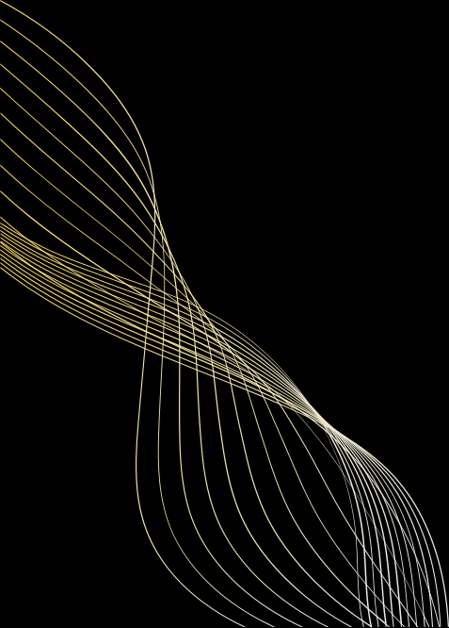

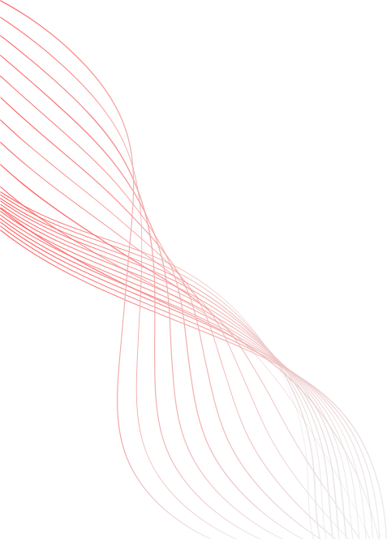
RESTORATION AND ENHANCEMENT OF AGED MANUSCRIPTS FOR RELIABLE TEXT EXTRACTION
By Aditya Mukati
Nehal Mantri
Nikhil Joshi

Slide 2
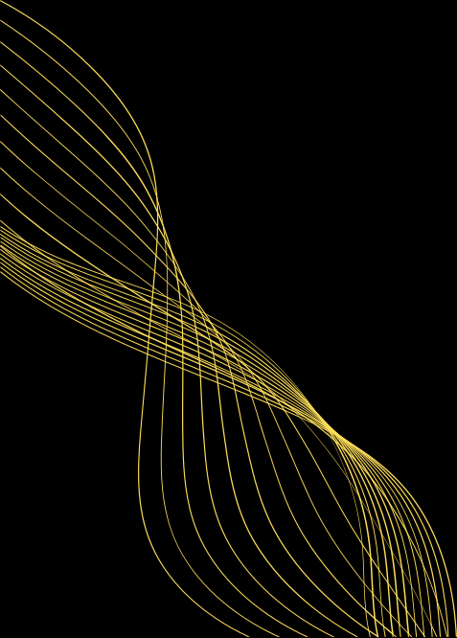
INTRODUCTION
Ancient manuscripts, especially in Tamil and Sanskrit, are a rich source of cultural and historical knowledge. However, most of these texts are in deteriorating condition due to aging, ink bleeding, uneven illumination, and complex script styles. Optical Character Recognition (OCR) on such manuscripts fails frequently because of poor input quality and lack of support for regional languages.
01

Slide 3

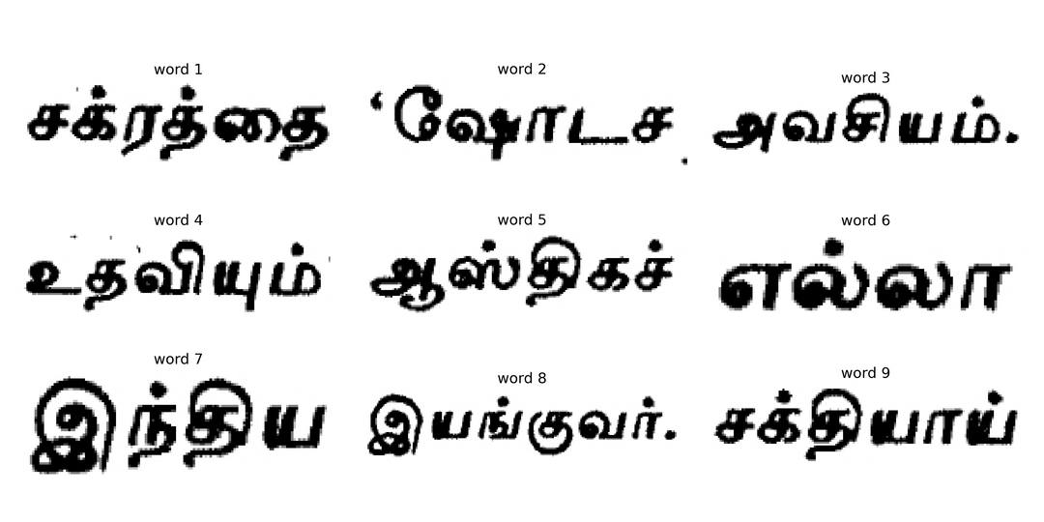
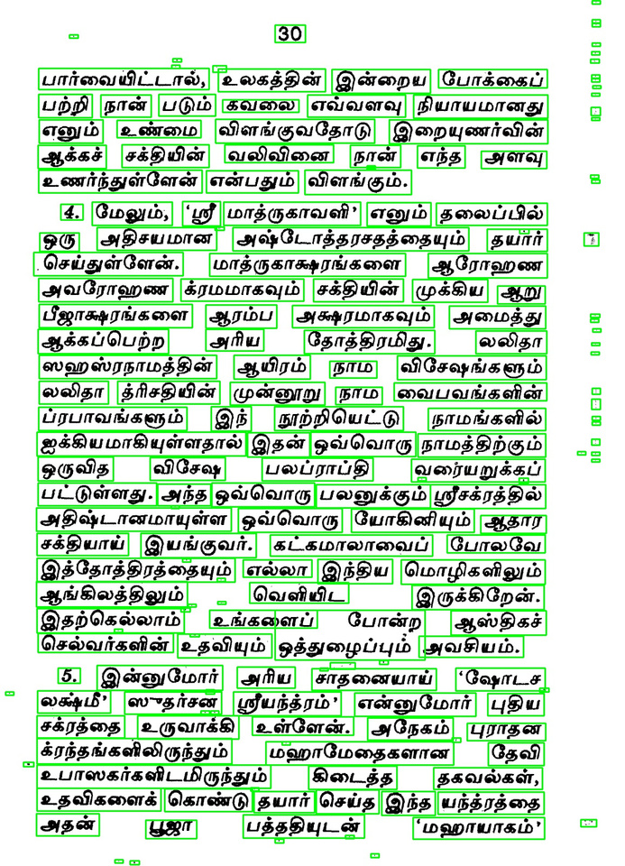
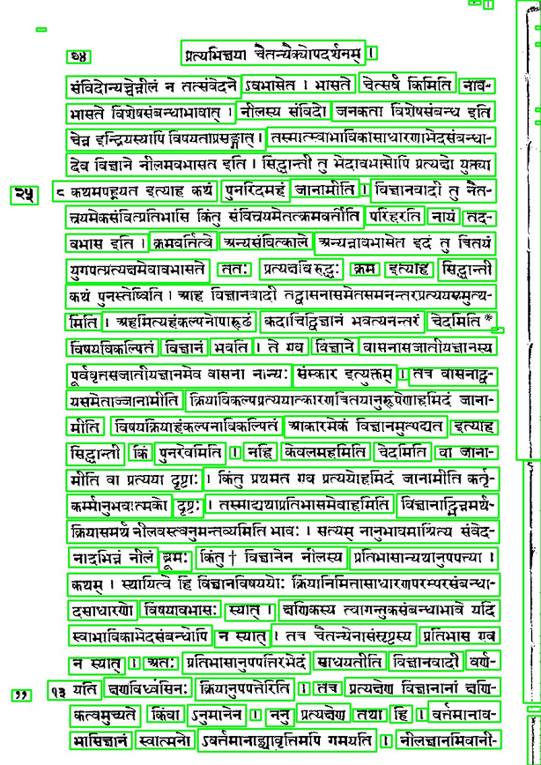
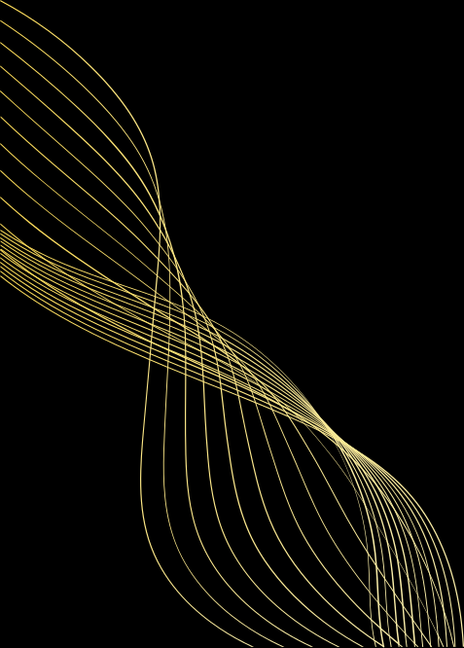
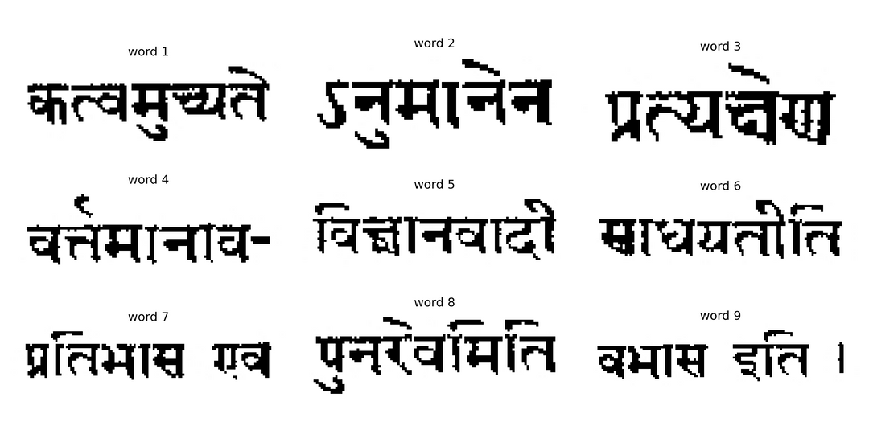
DATASET
Total Size: 246,000 word images | Languages Covered: Tamil and Sanskrit
02

Slide 4

Base Paper:-Working Methodology
Base Paper:-Application and Exploration of Image Processing Technology in Ancient Books Protection and Design by Zhou et al.
Zhou's team used basic image editing (grayscale, filters, binarization) to clean up ancient texts and fix page layouts. Their work improved visual readability but didn't include language recognition or advanced OCR
Main limits: No language classification, No deep learning used, OCR was limited and not optimized for multilingual texts.
03

Slide 5

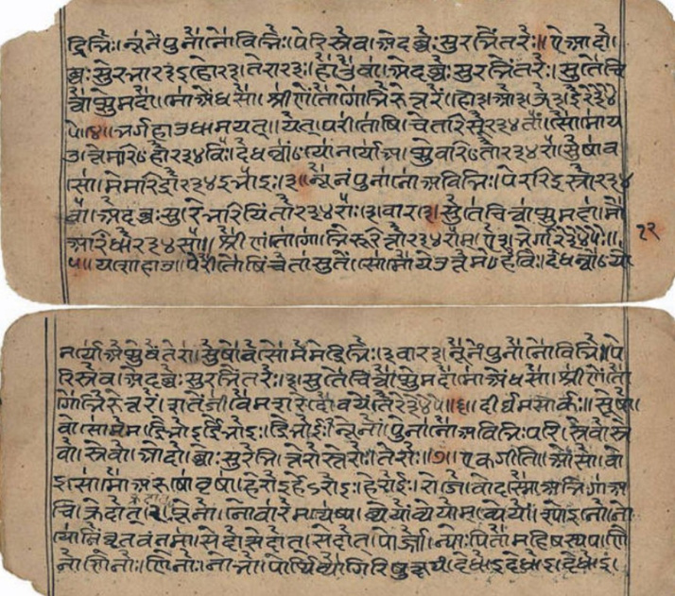
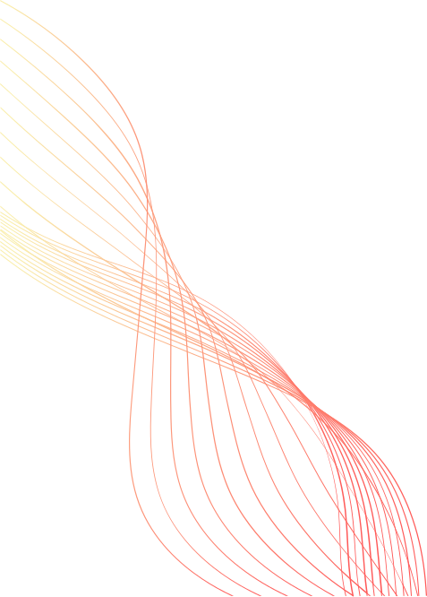
OUR IMPROVEMENT
Introduced a 7-step enhancement pipeline to drastically improve image quality.
Trained a CNN model on a custom dataset of 246,000 segmented Tamil and Sanskrit word images.
Used ESRGAN, a deep learning model, for super-resolution enhancement.
used language specific tesseract for OCR.
Added DeepSeek-R1, an LLM, to translate and summarize extracted text.
Added language classification step (98% accuracy using majority voting from word-level predictions) before OCR to improve accuracy.
Achieved 55% improvement in OCR Character Error Rate (CER) compared to raw images.
Sample Image
04

Slide 6
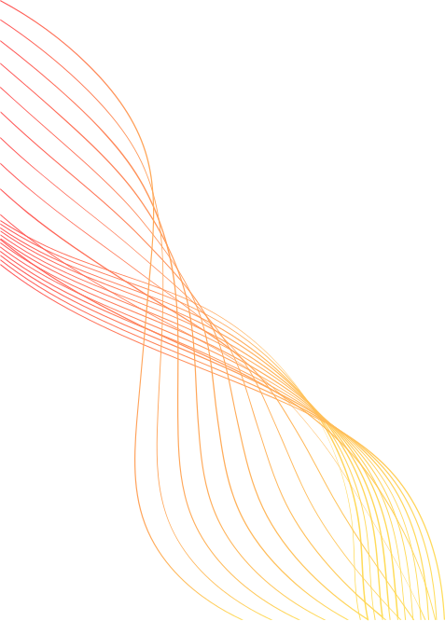
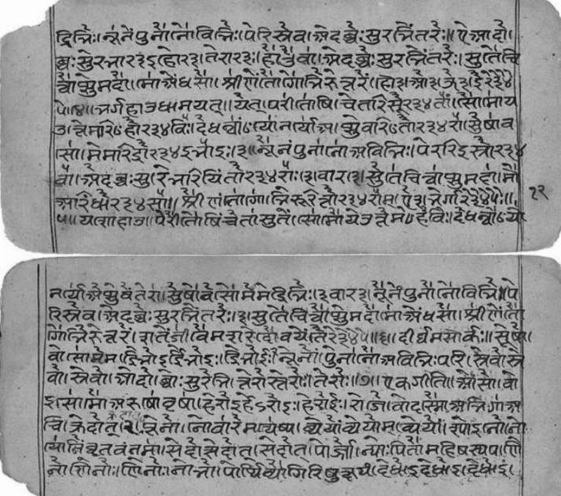
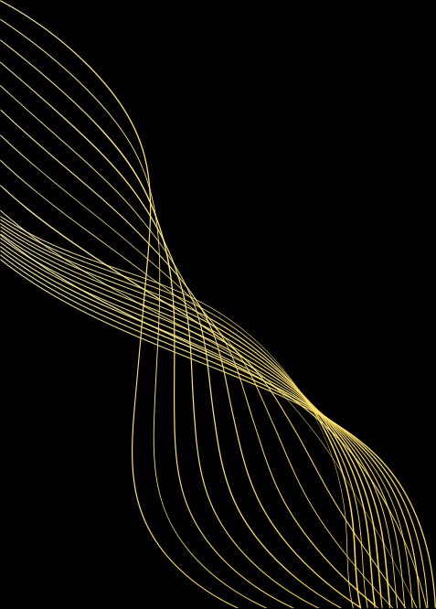
METHODOLOGY
Grayscale Conversion
Converts colored manuscript images to grayscale using weighted averaging.
Reduces data size and computation.
Preserves luminance which is essential for OCR to distinguish text from the background.
Formula:
Gray=0.2989×R+0.5870×G+0.1140×B\text{Gray} = 0.2989 \times R + 0.5870 \times G + 0.1140 \times BGray=0.2989×R+0.5870×G+0.1140×B
05

Slide 7
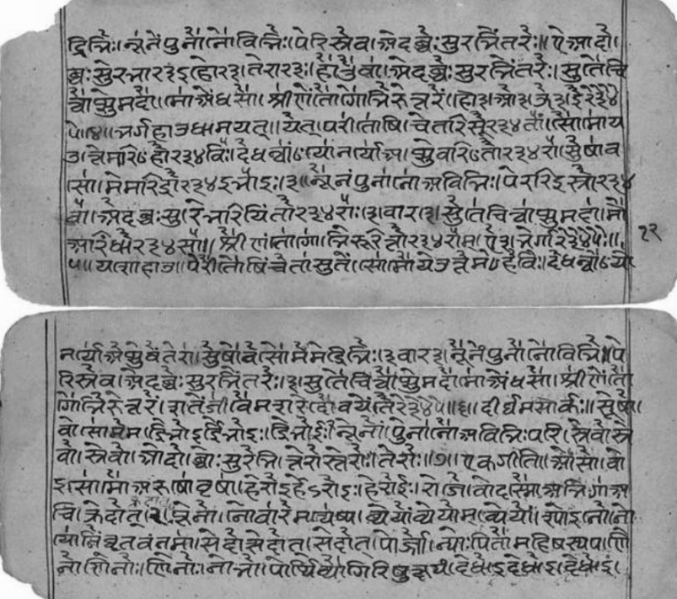
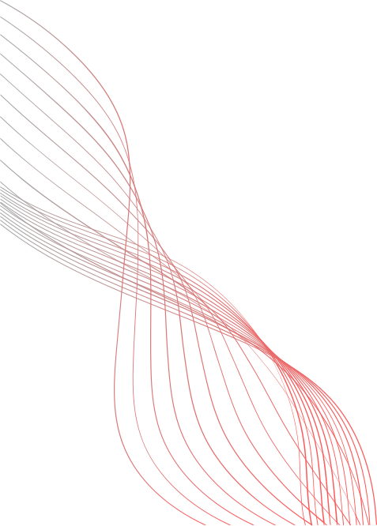
Wavelet Denoising
Removes high-frequency noise like ink dots and paper texture using wavelet transformation.
Maintains sharp edges of characters.
Ensures the strokes of letters aren’t lost or smudged.
06

Slide 8
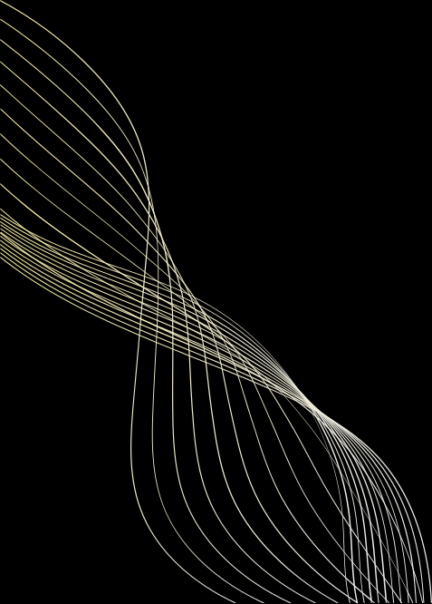
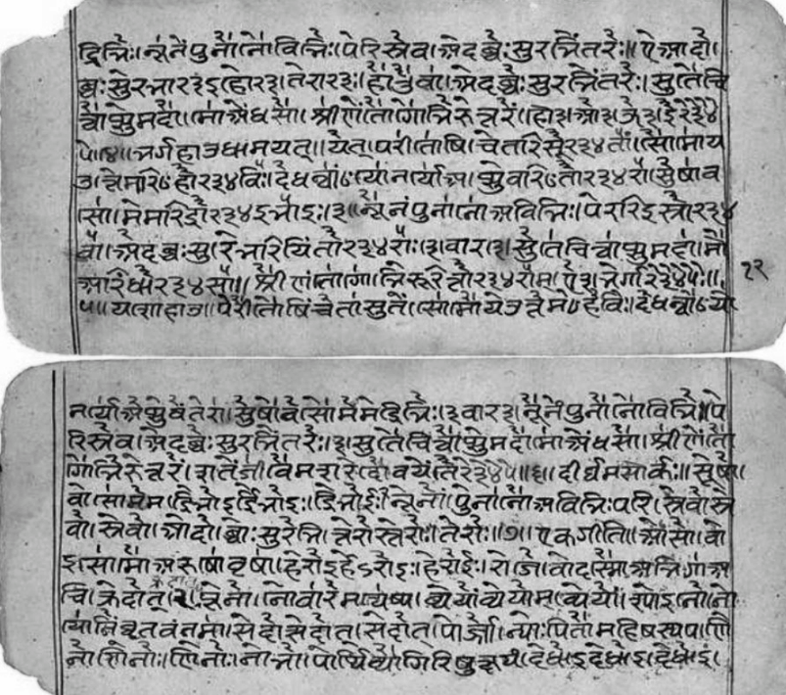
CLAHE Enhancement
CLAHE = Contrast-Limited Adaptive Histogram Equalization.
Boosts contrast in localized regions.
Avoids over-enhancement unlike global histogram equalization.
Helps highlight faded or lightly written characters in old texts.
07

Slide 9

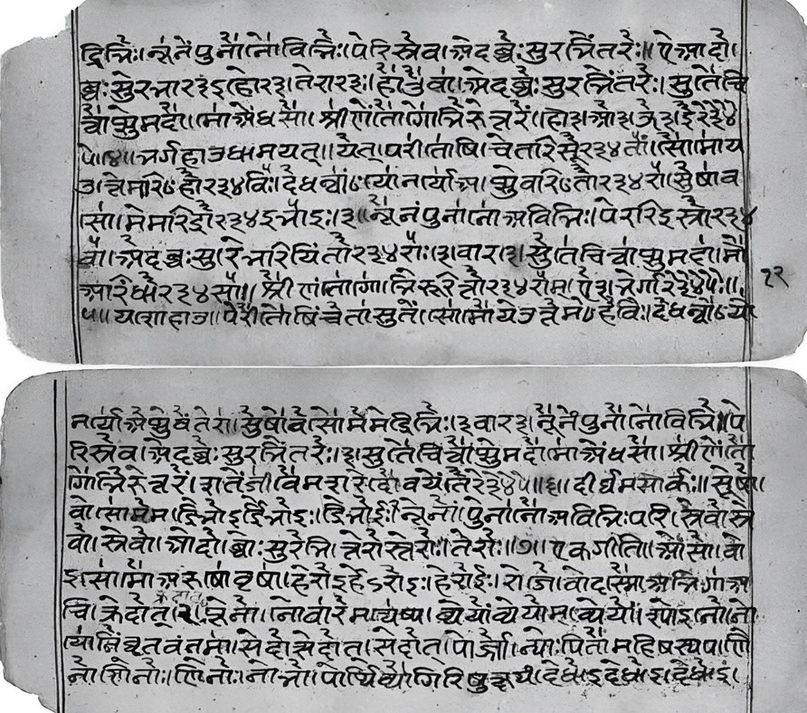
ESRGAN Super-Resolution
ESRGAN = Enhanced Super-Resolution Generative Adversarial Network.
Deep learning model trained to upscale and restore fine details in images.
Perfect for ancient texts with blurry or low-resolution scans.
Helps Tesseract OCR read characters with higher accuracy.
08

Slide 10


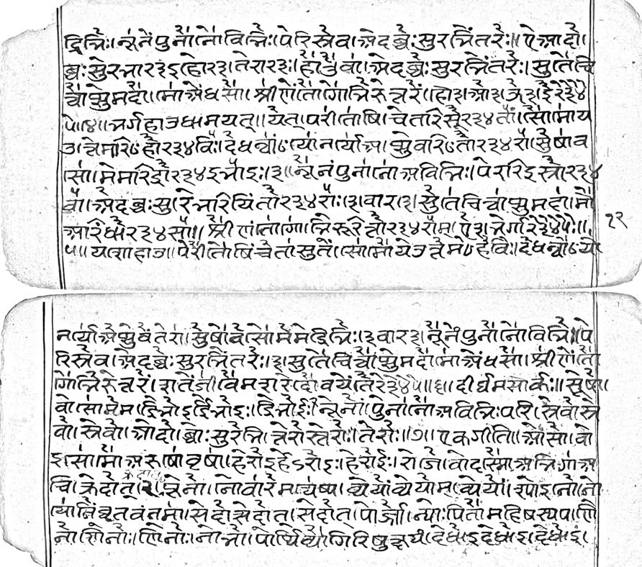
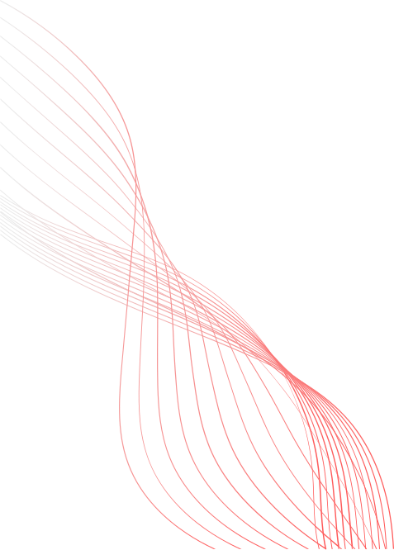
Adaptive Background Subtraction
Removes background textures, page stains, and ink bleed.
Separates foreground (text) from background using thresholding and filtering techniques.
Makes text pop out clearly for OCR.
09

Slide 11
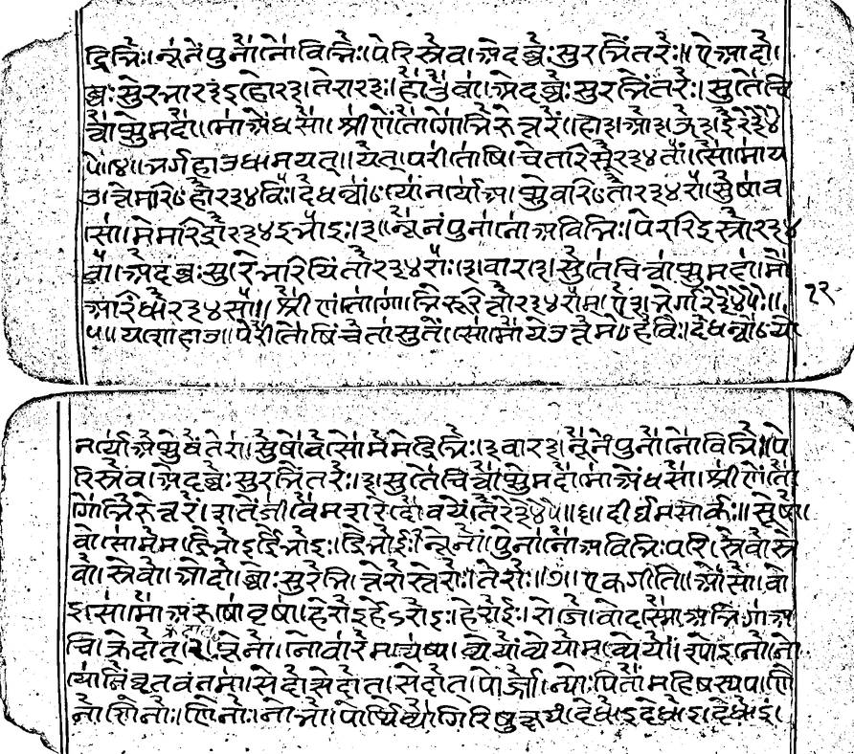
Sauvola Binarization
Adaptive binarization technique that chooses threshold based on local image statistics.
Handles uneven illumination very well — better than global thresholding like Otsu.
Ideal for manuscripts with shadowed or light areas.
10

Slide 12
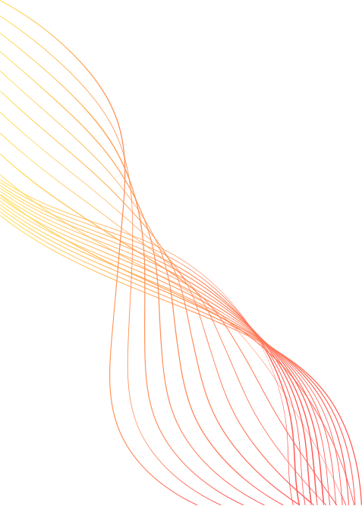
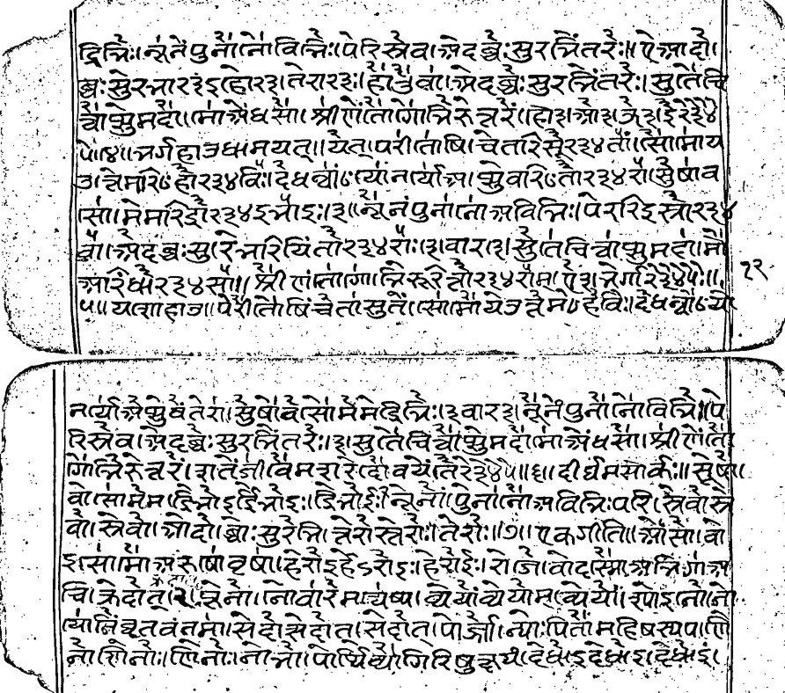
Unsharp Masking
Sharpens blurred text by enhancing edges using a blurred version of the image.
Improves readability without adding noise or artifacts.
Ideal for restoring faded or slightly out-of-focus documents.
11

Slide 13
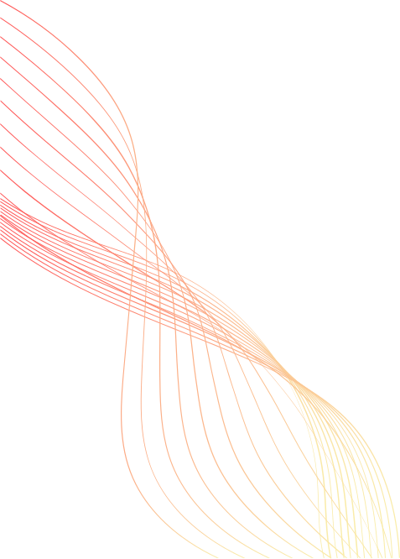
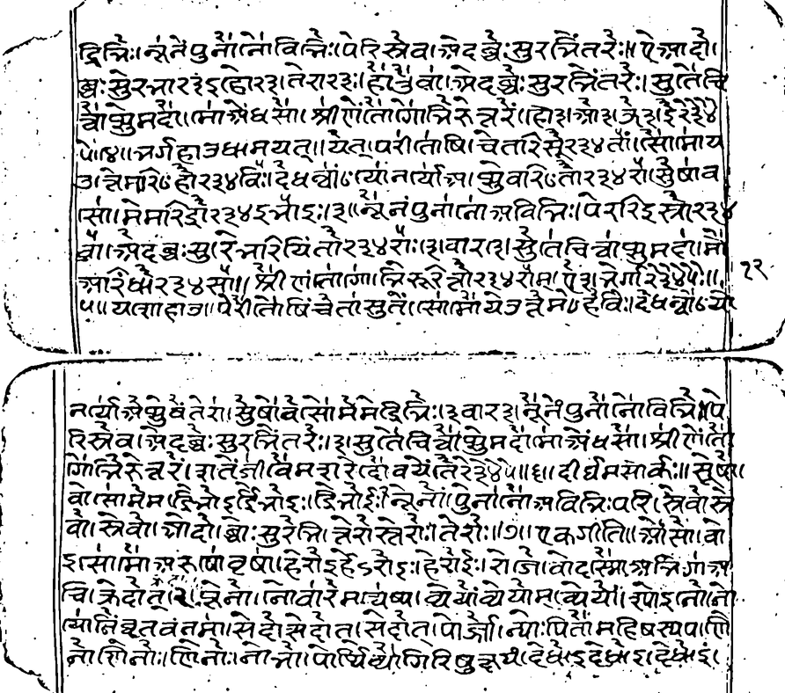
Median Filtering
Removes salt-and-pepper noise (ink dots, dust) without destroying edges.
Preserves sharpness better than Gaussian filters.
Perfect for cleaning up scans with scattered imperfections.
12

Slide 14
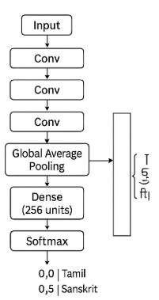
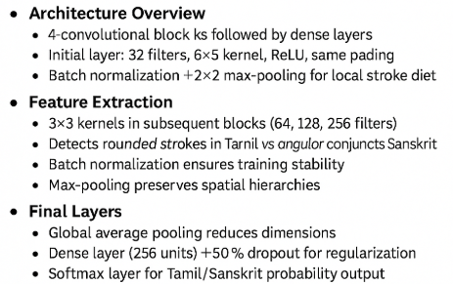
Model Architecture
12

Slide 15
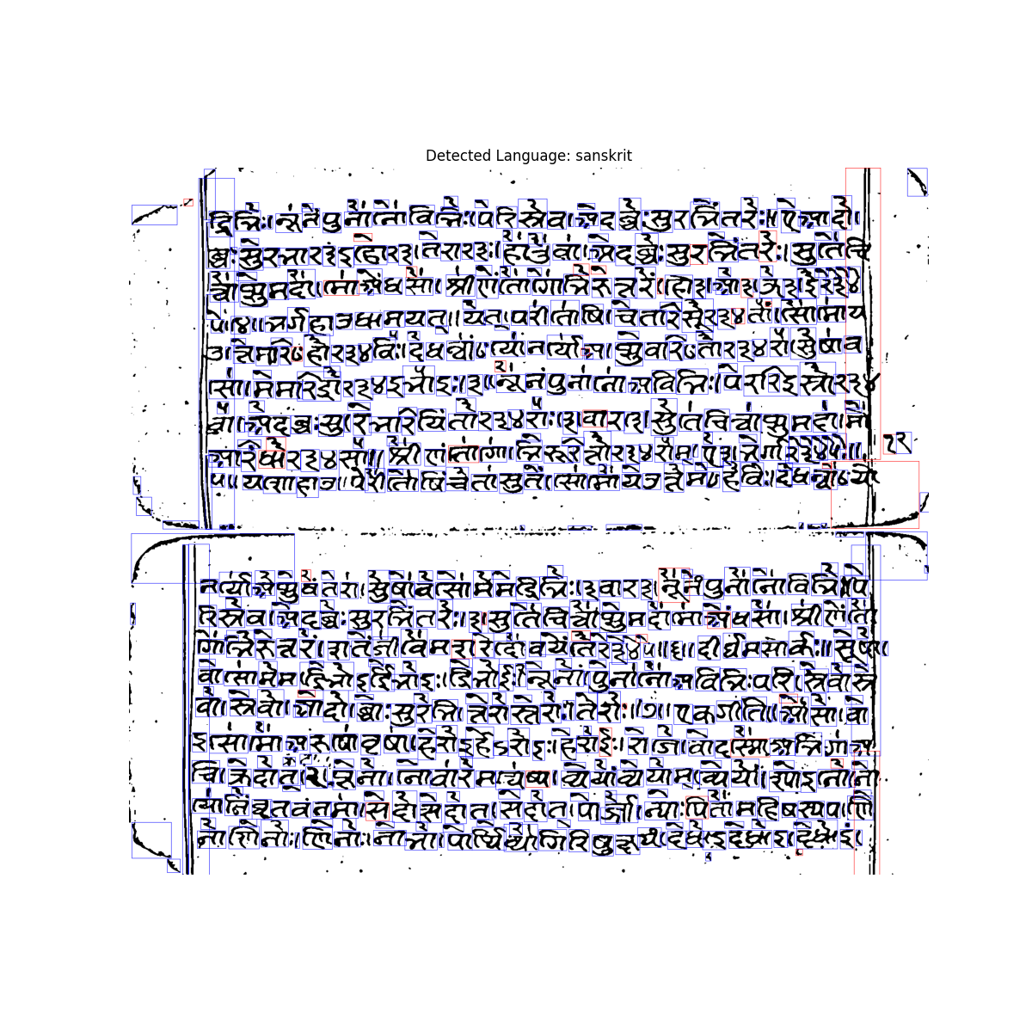
Language Classification
After preprocessing, individual words from the manuscript are passed through the trained CNN model, which predicts Tamil or Sanskrit based on morphological features.
A majority voting approach is used:
Each word's prediction contributes to the final decision.
The manuscript's language is determined by the most frequent word-level label.
Example:
772 words → Sanskrit
41 words → Tamil
(Blue boxes = Sanskrit, Red boxes = Tamil)
12

Slide 16
Applying Tesseract OCR
Now after processing the image and identifying the language, we pass the image through the language specific tesseract for OCR, and this is the output we get ->
द्विभिः । स पुनान विनिः पेरिस्वाद ब्रेः सुर चिंतरेः। ऐना दो। खः सुरमार(रते रारा है है व मेदः सुरभितरेः सुतेचि वायुमदेश माध सा। श्री ऐतिगामि नरेंश रे पमर्ग हा उद्यमयत् ॥ येता परीताषिचेतार से २३४ । सामाय उमरि७ हौ २३४॥ देवत्रयां नार्याच्या वरित २३४ ॥ सेाव सामे मरिदौ २३४ मा इशानं पुनाना अविभिः पेररिइस्रो २३४ बादः सारे रियितो २३४ रा ( शारदा सुतिचिचासुमा म अरिफेर ३४ स। श्री लालागा निरे तो २३४ रामा ऐशनेगा २३४५।। १२- ५॥ यत्शाहाजापेशीत खिंचे तां सुतें । (सामि येन ते मो० है विः। देवनौयो
el.
२।
ડ્યુટ
नार्याचे वै तेरा सुवासा में मत्रिः । इवार शनू ने नौना वित्रपे रिस्वदन्वेः सुरचितरे। सुते चिचाम दौमा ४ श्री
वो। स्त्रे वेो। यो दो! बोः सुरेनि तेरो स्तरोः। ते शेः ॥ एकजांतियों से! वो शंसामा परुषा वृषा हिरोइड रोइ हिरौई। रो जावोदासमा अगा चक्रे दोन नावारे मायायां यमये। रोइनो त्यानित्वतम्॥ से दो से दो ता से दोता पो जन्याः पिता महिष स्वा
12

Slide 17
AI Interpretation (Deepseek RI)
In an age long forgotten, amidst the celestial planes where divine winds whispered through sacred groves, a king named Nareśa, bearing the emblem of the rising sun, rose with valor to restore cosmic harmony. He was guided by the thoughts of the Devas (gods) and the soothing chants of mystics.
As he purified himself through punānaḥ (purification), the suras (gods) sent visions—air thick with fragrance and a voice from the sacred south wind, named Vāyu-Madeśa. There he beheld Śrī Aitigāmi, a luminous sage, who urged the king toward udyamaya—righteous endeavor.
The trinity of gods (Deva-trayāṁ) and the divine feminine (Nāryācā) watched over the realm. Rituals echoed with chants of Sharadā, the goddess of wisdom, and Sutici Chāsuma, a mystical spirit believed to guard knowledge.
In cryptic utterances, seers spoke of a celestial battle: Mahisha, a dark force born of chaos, clashing with the twin rivers of fate, watched over by Māyā and Yama (illusion and death). The hero—perhaps Rāma or an unnamed avenger—pierced the illusion, restoring dharma with thunderous resolve
12

Slide 18
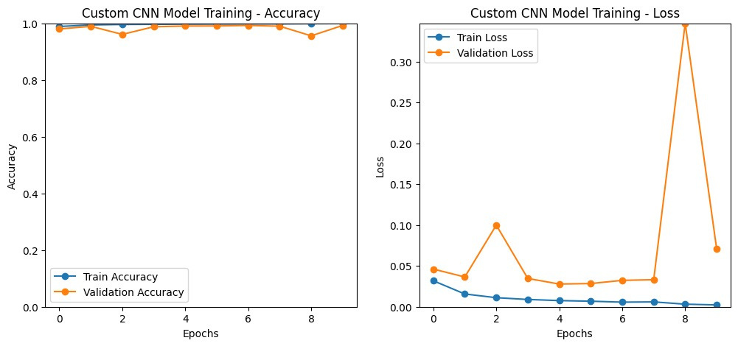
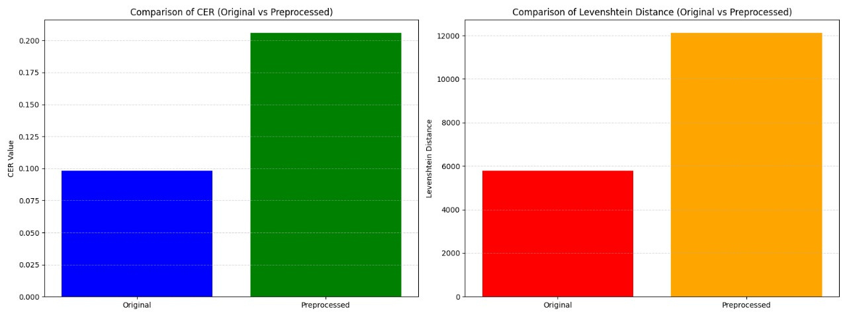
RESULTS
Language Classification CNN accuracy graph
OCR CER comparison
13

Slide 19
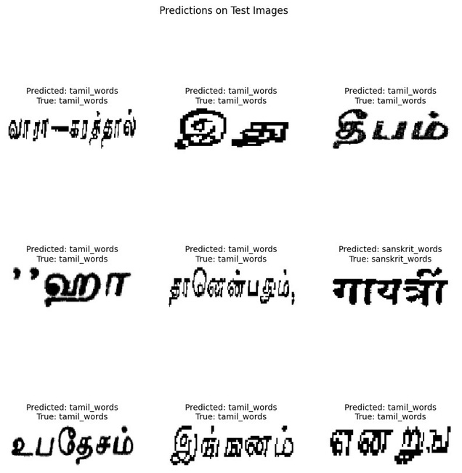
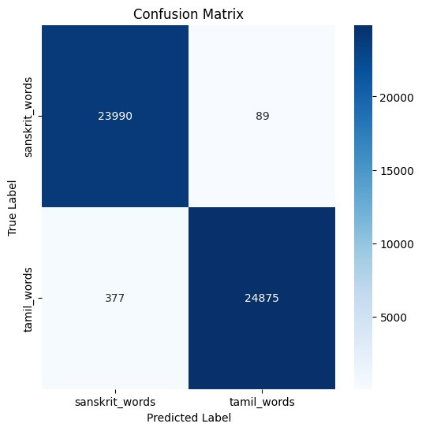
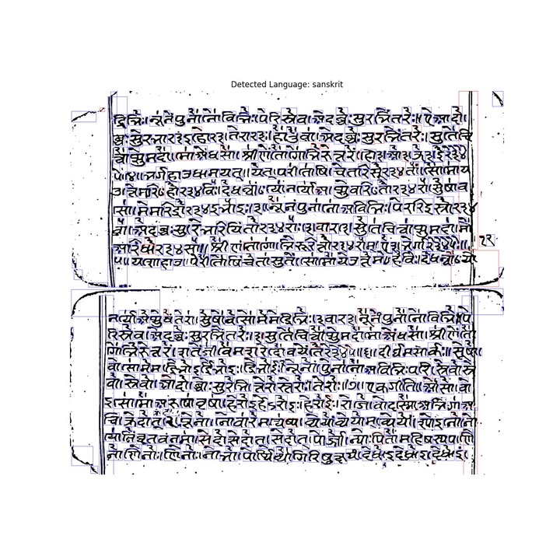
RESULTS-CONTD.
Testing CNN model on sample images
Language classification confusion matrix
Final Manuscript Classification: sanskrit
Votes Breakdown: {'sanskrit': 772, 'tamil': 41}
15

Slide 20
FUTURE WORK
Train our own OCR for Tamil/Sanskrit using Tesseract or custom LSTM models.
Extend language support to other Indian scripts like Pali, Grantha, Telugu, etc.
Deploy as a web/mobile app for historians, scholars, and archivists.
Introduce GAN-based ink bleed-through correction.
17

Slide 21
THANK YOU
17

